Slide 1
Solutions
IP Addressing +Subnetting

Slide 2
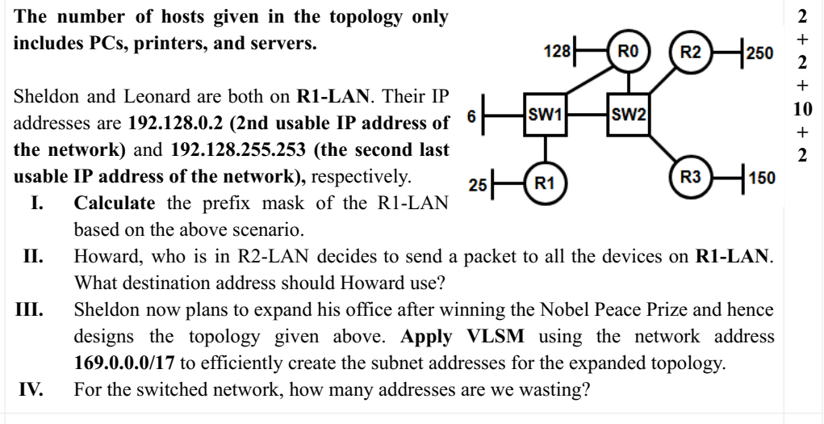
Network IP: 192.128.0.0
Broadcast IP: 192.128.255.255
NIP: 11000000.10000000.00000000.00000000
BIP: 11000000.10000000.11111111.11111111
Prefix length: 16
(ii) Direct broadcast IP of the R1-LAN: 192.128.255.255
(iii) The number of required Ips: R0-LAN: 128+1, R1-LAN: 25+1, R2-LAN: 250+1, R3-LAN: 150+1,
Switched Network: 6 Ips for end devices+5 Ips for 5 interfaces of four routers (2 for R0, 1 for R1-R3 each)
: 11

Slide 3
IP Block: 169.0.0.0/17
Hosts, H | H2=Host+2, |  | No. of net bits, Nb=32-Hb (prefix length) |  | Network IP | SM | For next subnet
251 | 253 | 8 | 24 | 256 | 169.0.0.0 | 255.255.255.0 | 256-255=1
151 | 153 | 8 | 24 | 256 | 169.0.0+1.0=169.0.1.0 | 255.255.255.0 | 256-255=1
129 | 131 | 8 | 24 | 256 | 169.0.1+1.0=169.0.2.0 | 255.255.255.0 | 256-255=1
26 | 28 | 5 | 27 | 32 | 169.0.2+1.0=169.0.3.0 | 255.255.255.224 | 256-224=32
11 | 13 | 4 | 28 | 16 | 169.0.3.0+32=169.0.3.32 | 255.255.255.240
(iv) The required IP of the switched network is 13. But 16 Ips have been allocated.
waste of IP: 16-13=3.

Slide 4
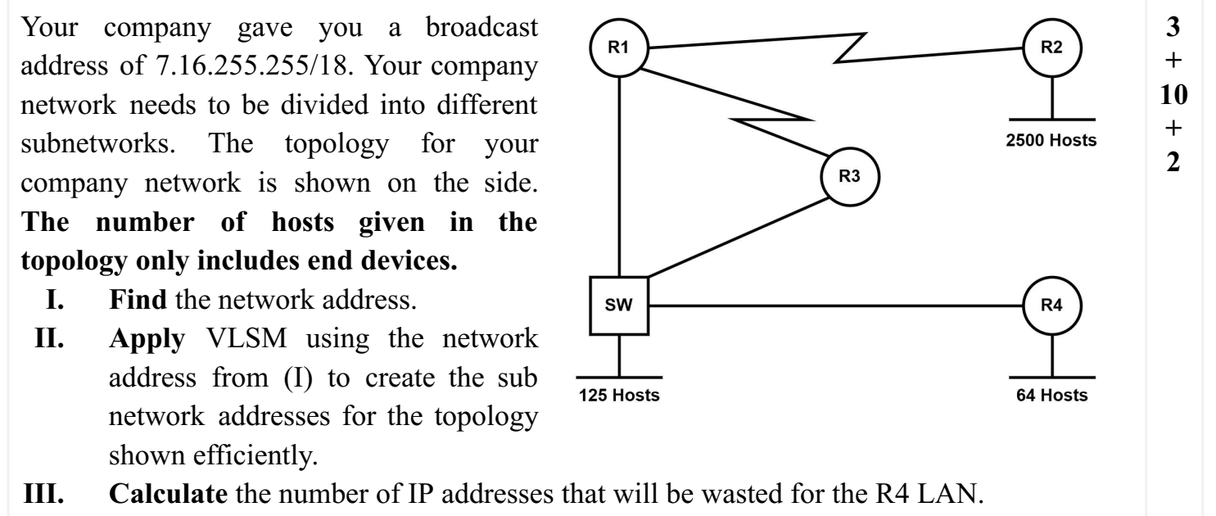
Broadcast IP: 7.16.255.255/18
00000111.00010000.11111111.11111111
Nework IP: 00000111.00010000.110000.00000000 (made all host bits 0)
7.16.192.0/18
(II) The number of required Ips: R2-LAN: 2500+1=2501, R4-LAN: 64+1=65, AccessNet:125+3=128, R1-R2 WAN: 2, R1-R3 WAN: 2

Slide 5
IP Block: 7.16.192.0/18
Hosts, H | H2=Host+2, |  | No. of net bits, Nb=32-Hb (prefix length) |  | Network IP | SM | For next subnet
2501 | 2503 | 12 | 20 | 4096 | 7.16.192.0 | 255.255.240.0 | 256-240=16
128 | 130 | 8 | 24 | 256 | 7.16.192+16.0=7.16.208.0 | 255.255.255.0 | 256-255=1
65 | 67 | 7 | 25 | 128 | 7.16.208+1.0=7.16.209.0 | 255.255.255.128 | 256-128=128
2 | 4 | 2 | 30 | 4 | 7.16.209.0+128=7.16.209.128 | 255.255.255.252 | 256-252=4
2 | 4 | 2 | 30 | 4 | 7.16.209.128+4=7.16.209.132 | 255.255.255.252
(iv) The required IP of the R4-LAN is 67. But 128 IPs have been allocated.
waste of IP: 128-67=61.

Slide 6
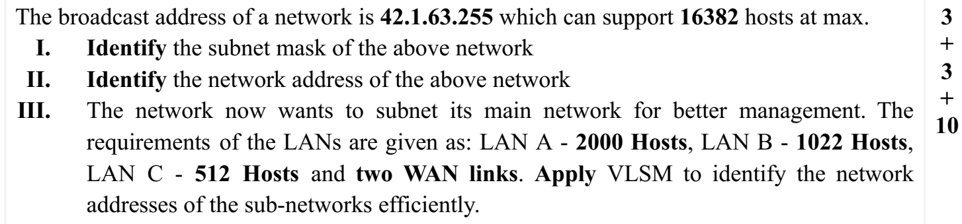
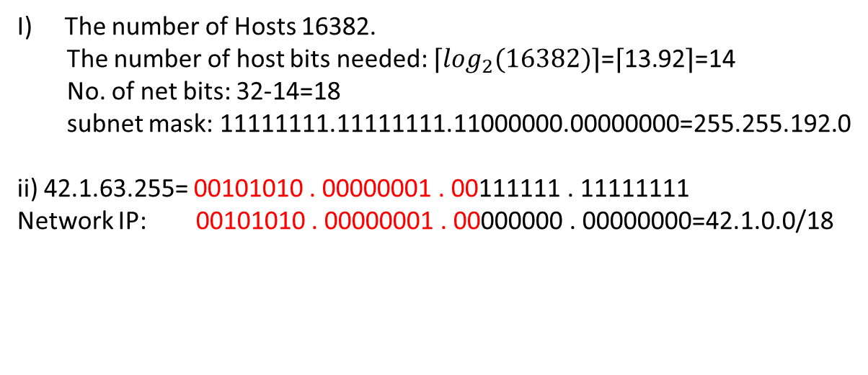

$$\left\lceil \log_{2}(16384)\right\rceil$$

Slide 7
IP Block: 41.1.0.0/18
Hosts, H | H2=Host+2, |  | No. of net bits, Nb=32-Hb (prefix length) |  | Network IP | SM | For next subnet
2000 | 2002 | 11 | 21 | 2048 | 41.1.0.0 | 255.255.248.0 | 256-248=8
1022 | 1024 | 10 | 22 | 1024 | 41.1.0+8.0=41.1.8.0 | 255.255.252.0 | 256-252=4
512 | 514 | 10 | 22 | 1024 | 41.1.8+4.0=41.1.12.0 | 255.255.252.0 | 256-252=4
2 | 4 | 2 | 30 | 4 | 41.1.12+4.0=41.1.16.0 | 255.255.255.252 | 256-252=4
2 | 4 | 2 | 30 | 4 | 41.1.16.0+4=41.1.16.4 | 255.255.255.252

Slide 8
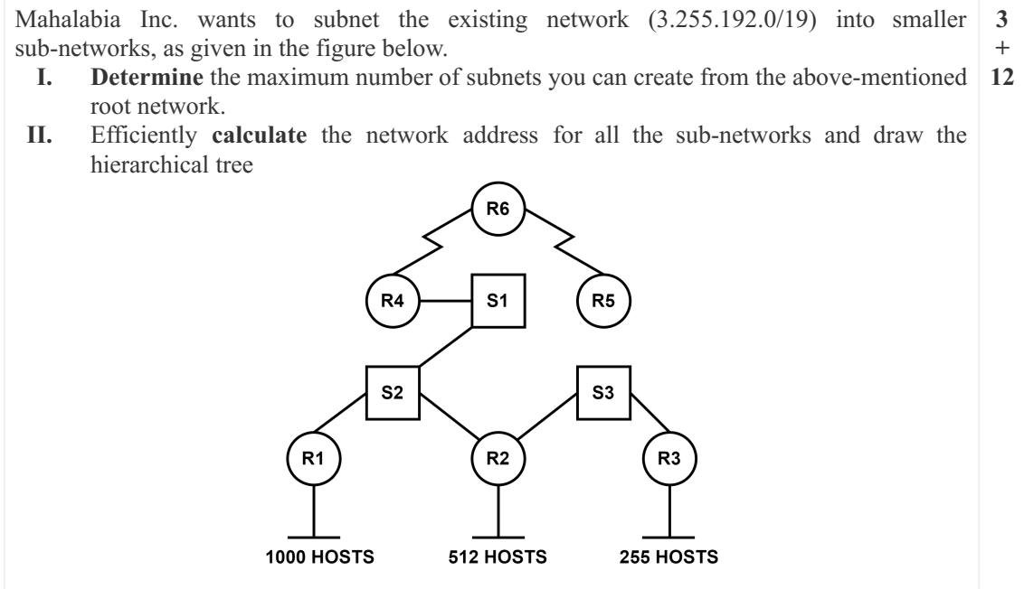
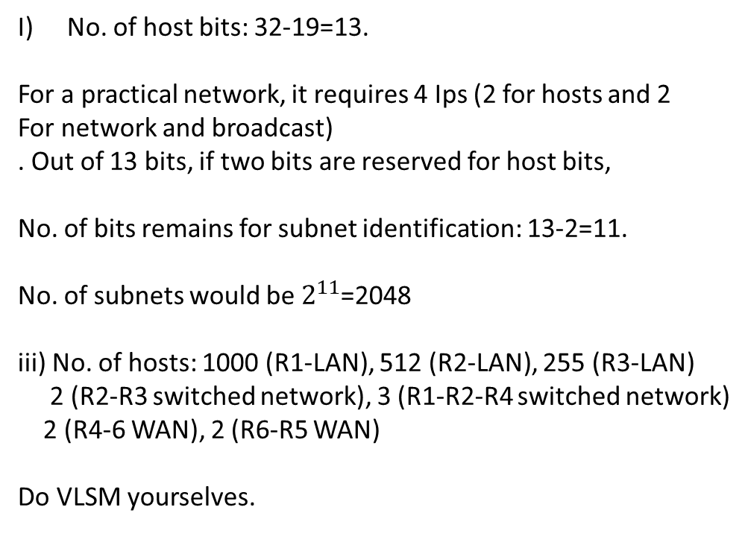
Note: Layer 2 Switch does not need any IP

Slide 9
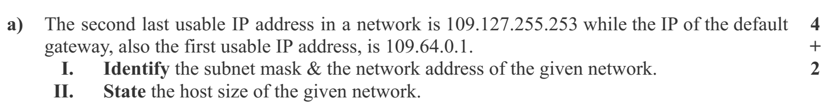

Last usable IP: 109.127.255.254
Broadcast IP: 109.127.255.255
First usable IP: 109.64.0.1
Network IP: 109.64.0.0
Network IP: 01101101.01000000.00000000.00000000
Broadcast: 01101101.01111111.11111111.11111111
First 10 bits same
No. of net bits: 10
No. of host bits: 32-10=22
SM: 11111111.11000000.00000000.00000000
: 255.192.0.0

